Slide 1
PAIR OF LINEAR EQUATIONS IN TWO VARIABLES
SESSION -6

Slide 2
Some Solved Examples

Slide 5
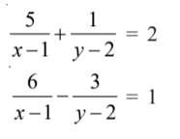
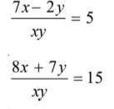
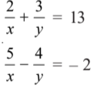
Dear students, so far we have learnt all the algebraic methods of solving a system of linear equations in two variables.
Let us now discuss a system of equations which does not actually contain linear equations in two variables but can be reduced to the same.
For example:
All of the above are the system of equations which can be reduced to system of linear equations in two variables.
Now, let us learn how to solve such systems of equations.

Slide 6
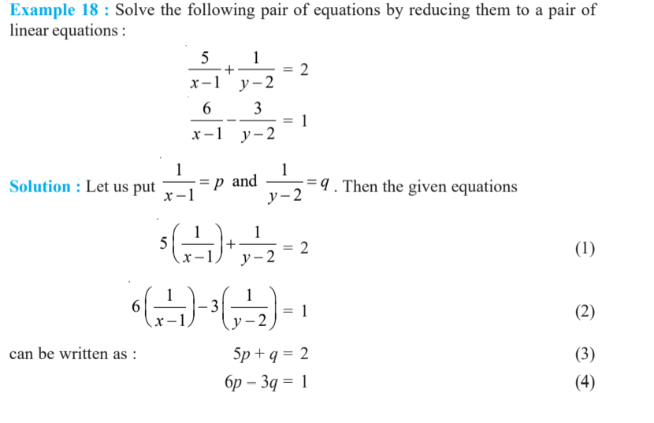
Consider the following example:

Slide 7
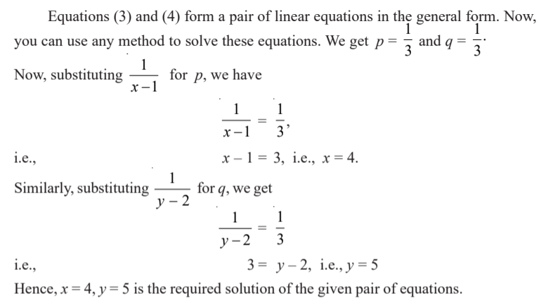

Slide 8
Let us understand the method of solving such a system by watching this video
https://youtu.be/wGGAxRkiZ8Y

Slide 11
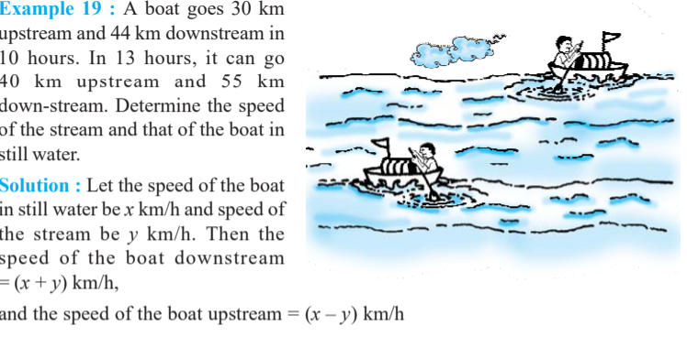
Now, let us try some word problems based on the learnt concept.

Slide 13
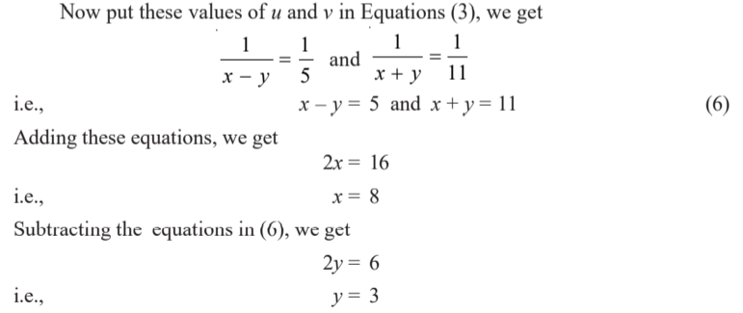
On solving (4) and (5) we get, u= 1/5 and v= 1/11
Thus, speed of boat in still water is 8 km/h and speed of the stream is 3 km/h.

Slide 16
MCQ Assignment
1. What will be the solution of these equations ax+by=a-b, bx-ay=a+b
(a) x=1, y=2 (b) x=2,y=-1 (c) x=-2, y=-2 (d) x=1, y=-1
2. If x=a, y=b is the solution of the pair of equation x-y=2 and x+y=4 then what will be value of
a and b
(a) 2,1 (b) 3,1 (c) 4,6 (d) 1,2
3. If a pair of linear equations is consistent, then the lines will be
(a) parallel (b) always coincident (c) always intersecting (d) intersecting /coincident
4. The pair of equations, y=0 and y = -7 has
(a) one solution (b) 2 solutions (c) no solutions (d) infinite solutions
5. For the equation cx – y = 2 and 6x – 2y = 3 to have infinite solutions, the value of c =
(a) 3 (b) - 3 (c) -12 (d) no value

Slide 17
6. The sum of the digits of a two digit number is 9. If 27 is added to it the digits are reversed. The
number is
(a) 27 (b) 36 (c) 45 (d) 54
7. For the equation x – 2y = 3 and 3x + ky = 1 to have unique solution,
(a) k = - 6 (b) k ≠ -6 (c) k = 0 (d) no value
8. If the lines given by 3x +2ky = 2 and 2x + 5y + 1 = 0 are parallel, then k =
(a) - 5/4 (b) 2/5 (c) 15/4 (d) 3/4
9. A pair of linear equations which have a unique solution given by x = 2 and y = - 3 is given by
(a) x+ y = -1 (b) 2x + 5y = - 11 (c) 2x – y = 1 (d) x – 4y – 14 = 0
2x – 3y = - 5 4x + 10y = - 22 3x + 2y = 0 5x – y – 13 = 0

Slide 18
10. The pair of equations x = a and y = b graphically represents lines which are
(a) parallel (b) intersecting at (b, a)
(c) coincident (d) intersecting at (a, b)
11. For what value of k, do the equations 3x – y + 8 = 0 and 6x – ky = –16 represent coincident lines?
(a) 1/2 (b) – 1/2 (c) 2 (d) –2
12. One equation of a pair of dependent linear equations is –5x + 7y = 2. The second equation can be
(a) 10x + 14y + 4 = 0 (b) –10x – 14y + 4 = 0
(c) –10x + 14y + 4 = 0 (d) 10x – 14y = –4
13. Raju buys 7 books and 6 pens for Rs.2750 and Anand buys 3 books and 5 pens of same kind for Rs1300. What are the respective costs of a book and a pen? [NSTSE 2019]
(a) 350, 50 (b)500, 75 (c) 250, 100 (d) 500, 50
14. A and B can together do a piece of work in 30 days. A worked for 16 days, B finishes the remaining work alone in 44 days. In how many days shall B finish the whole work alone?
(a) 30days (b) 40 days (c) 60 days (d) 70 day [ACER 2019]

